Slide 1
Site Reliability Engineer (SRE)
By
Vivek Arora

Slide 2
Software Development LifeCycle
SDLC - The Software Development Life Cycle (SDLC) is a structured process used for developing software systems. It outlines the stages involved in the development process from the initial planning to the final deployment and maintenance of the software. Here’s an overview of the typical phases in the SDLC:
Planning
Objective: Define the scope, goals, and objectives of the project. This phase involves gathering high-level requirements, determining resources, and estimating costs and timelines.
Activities: Feasibility study, resource allocation, project scheduling, and cost estimation.

Slide 3
Requirements Gathering and Analysis
Objective: Collect detailed requirements from stakeholders and analyze them to create a clear and comprehensive specification.
Activities: Requirements documentation, stakeholder interviews, use case analysis, and creation of Software Requirement Specification (SRS).
Design
Objective: Create a blueprint for the software solution. This includes designing the architecture, database, user interfaces, and other system components.
Activities: High-level design (HLD), low-level design (LLD), database schema design, and user interface design.
Implementation (Coding)
Objective: Translate the design documents into actual code. This phase involves writing, compiling, and debugging the source code.
Activities: Code development, integration of different modules, and code review.
Testing
Objective: Ensure the software is free from defects and meets the specified requirements. This phase involves various testing methods to identify and fix bugs.
Activities: Unit testing, integration testing, system testing, acceptance testing, and bug fixing.

Slide 4
Deployment
Objective: Release the software to the end-users. This phase involves installing the software on production servers and making it available for use.
Activities: Deployment planning, environment setup, software installation, and user training.
Maintenance
Objective: Address any issues that arise post-deployment and make necessary updates or improvements. This phase ensures the software continues to operate smoothly.
Activities: Bug fixes, updates, performance enhancements, and support services.
Evaluation
Objective: Review the entire process and the final product to ensure it meets all requirements and to identify lessons learned for future projects.
Activities: Performance analysis, user feedback collection, and post-implementation review.

Slide 5
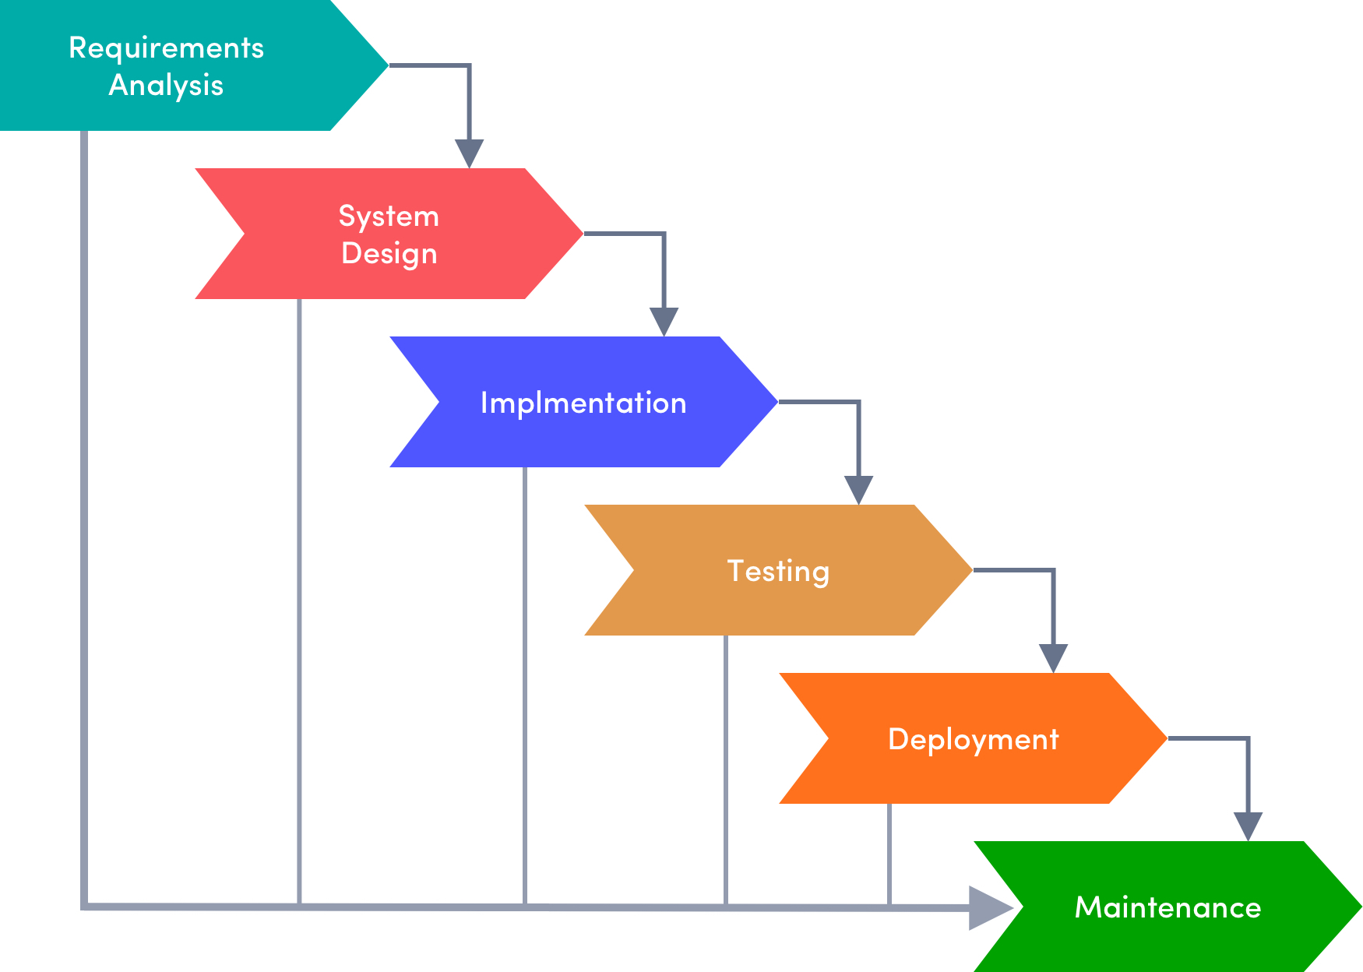

Slide 6
Waterfall Model
The Waterfall model is one of the earliest and most traditional approaches to software development within the Software Development Life Cycle (SDLC). It follows a linear and sequential design process, where each phase must be completed before the next one begins. This model is called "Waterfall" because progress flows downwards, like a waterfall, through several phases.
Key Phases of the Waterfall Model
Requirements Gathering and Analysis
Objective: Capture all the system requirements in detail before any design or development begins.
Activities: Stakeholder interviews, requirement documentation, and creation of the Software Requirement Specification (SRS) document.

Slide 7
System Design
Objective: Design the overall architecture of the software system based on the requirements gathered.
Activities: High-level system design, low-level design, data models, and interface designs.
Implementation (Coding)
Objective: Convert the system design into source code.
Activities: Development of software components, integration of modules, and code testing.
Integration and Testing
Objective: Verify that the entire system works as intended.
Activities: Unit testing, integration testing, system testing, and bug fixing.

Slide 8
Deployment
Objective: Deploy the software to the production environment where it becomes accessible to users.
Activities: System installation, user training, and deployment into the live environment.
Maintenance
Objective: Provide ongoing support and make necessary updates after the software is deployed.
Activities: Bug fixes, updates, and enhancements to ensure the system continues to meet user needs.

Slide 9
Characteristics of the Waterfall Model
Sequential Process: Each phase must be completed before the next phase begins, with no overlap between phases.
Documentation: Extensive documentation is required for each phase, especially during the requirements and design stages.
Inflexibility to Changes: Once a phase is completed, going back to make changes is difficult and costly. This makes it important to have clearly defined and unchanging requirements from the start.
Simple and Easy to Understand: The linear approach makes it easy to manage and understand, especially for smaller projects with well-defined requirements.

Slide 10
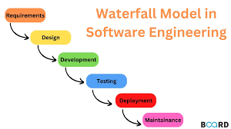

Slide 11
Advantages of the Waterfall Model
Structured Approach: The clear, linear progression through phases provides structure and discipline.
Easy to Manage: Due to its rigidity and defined stages, project management and progress tracking are straightforward.
Well-Suited for Smaller Projects: Works well for projects with clear, stable requirements and no expected changes.

Slide 12
Disadvantages of the Waterfall Model
Inflexible to Changes: Once a phase is completed, revisiting it for changes can be difficult and costly, which is problematic if requirements evolve.
Late Testing: Testing is done only after the implementation phase, which may lead to finding defects late in the process.
Risk of Project Failure: If a problem is discovered late in the cycle, it could require significant rework or even lead to project failure.

Slide 13
Agile Model
The Agile model is an iterative and incremental approach to software development, where requirements and solutions evolve through collaboration between cross-functional teams. Agile emphasizes flexibility, customer collaboration, and rapid delivery of functional software, breaking down the project into smaller, manageable pieces called iterations or sprints. Each iteration results in a working product, allowing teams to adapt to changing requirements over time.

Slide 14
Key Principles of Agile (Based on the Agile Manifesto)
Customer Collaboration Over Contract Negotiation: Continuous customer interaction is valued over rigid contracts.
Individuals and Interactions Over Processes and Tools: Agile emphasizes human interaction, teamwork, and collaboration.
Working Software Over Comprehensive Documentation: The primary measure of progress is working software, not lengthy documentation.
Responding to Change Over Following a Plan: Agile welcomes changes even late in development, ensuring flexibility and adaptation.

Slide 15
Phases of Agile Development
Agile doesn’t follow a strict sequence like the Waterfall model. Instead, it’s structured around iterative cycles or sprints, typically lasting 2-4 weeks. Each sprint goes through the following general steps:
Concept: Project is defined, stakeholders identify the initial scope, and a high-level vision is established.
Inception: Teams are formed, tools and technologies are selected, and an initial backlog (list of prioritized features or tasks) is created.
Iteration/Sprint: Each iteration includes:
Sprint Planning: At the start of each sprint, teams plan what features will be developed during the sprint.
Design and Development: Features are designed and coded during the sprint.
Testing: Continuous testing is done alongside development to ensure that the software meets quality standards.
Review: At the end of the sprint, a review is conducted to demonstrate the working product to stakeholders.
Retrospective: Teams hold a retrospective to reflect on the process and identify areas for improvement.
Release: After a few iterations or sprints, a product increment is released to the customer for feedback and potential deployment.
Maintenance: Continuous maintenance is performed to address bugs or introduce additional features based on user feedback.
Feedback and Adaptation: User feedback is gathered continuously, and changes can be made to the product in subsequent sprints.

Slide 16
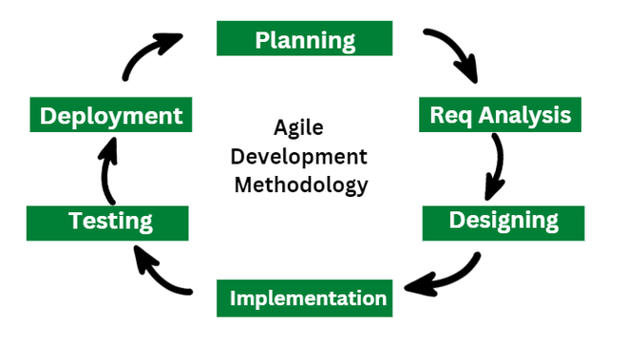

Slide 17
Advantages of Agile Model
Flexibility and Adaptability: Agile allows for changes to be made at any point during the development process, even late in the project.
Customer Satisfaction: Regular delivery of working software ensures continuous feedback and alignment with customer needs.
Early and Frequent Delivery: Short sprints mean that usable software is delivered early and regularly.
Improved Collaboration: Agile fosters communication between teams and stakeholders, improving collaboration and teamwork.
Risk Reduction: Regular testing and feedback loops help identify issues early, reducing the overall risk of project failure.

Slide 18
Disadvantages of Agile Model
Less Predictable: Since Agile is flexible and embraces change, it can be difficult to predict timelines, costs, or the final outcome early in the project.
Requires Active Customer Involvement: Constant

Slide 19
Agile vs Waterfall Model
 | Waterfall Model | Agile Model
Development Approach | Linear and Sequential: Development follows a strict sequence of phases: Requirements → Design → Implementation → Testing → Deployment → Maintenance. | Iterative and Incremental: Development is broken into smaller iterations or sprints, each producing a potentially shippable product increment.
Flexibility | Inflexible: Once a phase is completed, it is difficult and costly to go back and make changes. Requirements must be clearly defined from the start. | Highly Flexible: Welcomes changes even late in development. Requirements can evolve based on customer feedback.
Documentation | Extensive Documentation: Heavy emphasis on documentation at every stage. The project is guided by detailed plans, specifications, and records. | Minimal Documentation: Focuses on working software over comprehensive documentation. Documentation is done as needed and is less formal.
Customer Involvement | Limited Customer Involvement: Customer involvement is mainly at the beginning (requirements) and end (delivery) of the project. | High Customer Involvement: Customers are involved throughout the process, providing feedback during each iteration or sprint.
Project Size and Complexity | Suitable for Small, Well-Defined Projects: Works best when requirements are clear, stable, and unlikely to change. Ideal for projects with a fixed scope and low complexity. | Suitable for Complex, Evolving Projects: Ideal for projects where requirements are expected to change or are not fully understood at the outset. Works well for complex and large-scale projects.
Testing | Testing After Development: Testing occurs after the implementation phase, which may lead to the discovery of issues late in the process. | Continuous Testing: Testing is integrated into each iteration, allowing for early detection and resolution of defects.
Time and Cost Estimation | Predictable: Provides a clear timeline and cost estimate early in the project, which is useful for fixed-scope projects. | Variable: Time and cost can be more difficult to predict due to the iterative nature and flexibility of Agile.

Slide 20
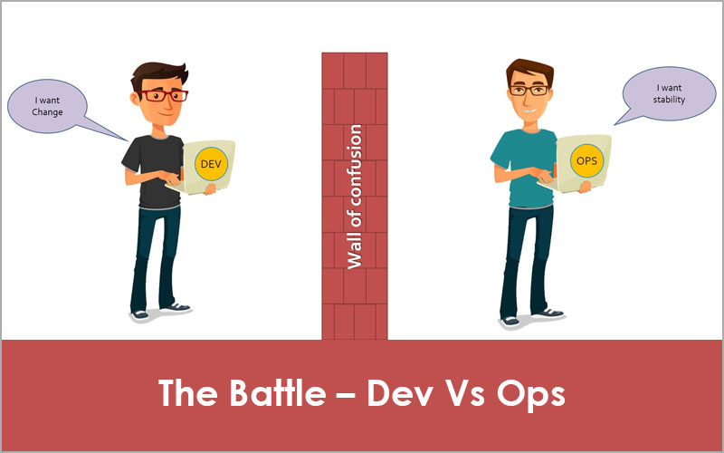

Slide 21
Devops
DevOps is a set of practices, principles, and cultural philosophies that integrates and automates the work of software development (Dev) and IT operations (Ops) teams. The primary goal of DevOps is to shorten the software development life cycle and deliver high-quality software continuously. By fostering a culture of collaboration and shared responsibility, DevOps aims to enhance the speed, efficiency, and reliability of software delivery.

Slide 22
Key Principles of DevOps
Collaboration and Communication:
DevOps emphasizes breaking down silos between development, operations, and other IT teams.
Continuous communication and collaboration are essential to ensure that everyone is aligned with the project goals.
Automation:
Automating repetitive tasks such as code integration, testing, deployment, and monitoring is crucial.
Continuous Integration (CI) and Continuous Delivery (CD) pipelines are core practices, enabling faster and more reliable releases.
Continuous Integration (CI):
Developers frequently integrate their code changes into a shared repository.
Automated builds and tests are triggered, allowing early detection and resolution of integration issues.
Continuous Delivery (CD):
Code changes are automatically tested and prepared for release to production.
CD ensures that software can be reliably released at any time, reducing manual intervention and human error.
Infrastructure as Code (IaC):
Managing and provisioning computing infrastructure through machine-readable configuration files, rather than physical hardware configuration or interactive configuration tools.
Tools like Terraform, Ansible, and AWS CloudFormation enable teams to treat infrastructure similarly to application code.

Slide 23
6. Monitoring and Logging:
Continuous monitoring of applications and infrastructure is critical for detecting issues early and understanding system performance.
Logs and monitoring data provide insights that help in troubleshooting, performance tuning, and enhancing user experience.
7. Microservices Architecture:
Applications are broken down into small, independent services that can be developed, deployed, and scaled independently.
This architecture complements DevOps by enabling more agile and flexible software delivery.
8. Security (DevSecOps):
Integrating security practices within the DevOps process ensures that security is considered at every stage of development.
Automated security testing, vulnerability scanning, and compliance checks are part of the CI/CD pipeline.

Slide 24
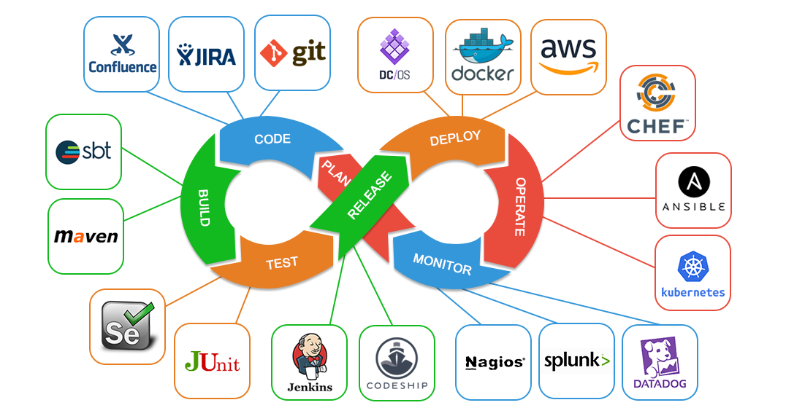

Slide 25
Benefits of DevOps
Faster Delivery:
By automating processes and fostering collaboration, DevOps reduces the time needed to deliver new features and updates.
Improved Collaboration:
DevOps breaks down barriers between development, operations, and other teams, leading to better teamwork and shared responsibility.
Higher Quality Software:
Continuous testing, integration, and monitoring ensure that defects are identified and addressed early, improving the overall quality of the software.
Increased Deployment Frequency:
With automated pipelines, teams can deploy code changes more frequently and reliably, enabling faster feedback loops and quicker releases.
Scalability and Flexibility:
DevOps practices like microservices and IaC enable organizations to scale applications and infrastructure easily in response to changing demands.
Better Security:
By incorporating security into the CI/CD pipeline, DevOps ensures that applications are more secure and compliant with regulations.

Slide 26
What is SRE?
Site Reliability Engineering (SRE) is a discipline that incorporates aspects of software engineering and applies them to infrastructure and operations problems. The primary goals of SRE are to create scalable and highly reliable software systems. SRE originated at Google and has since been adopted by various organizations to bridge the gap between development and operations teams, focusing on automation, system reliability, and resilience.

Slide 27
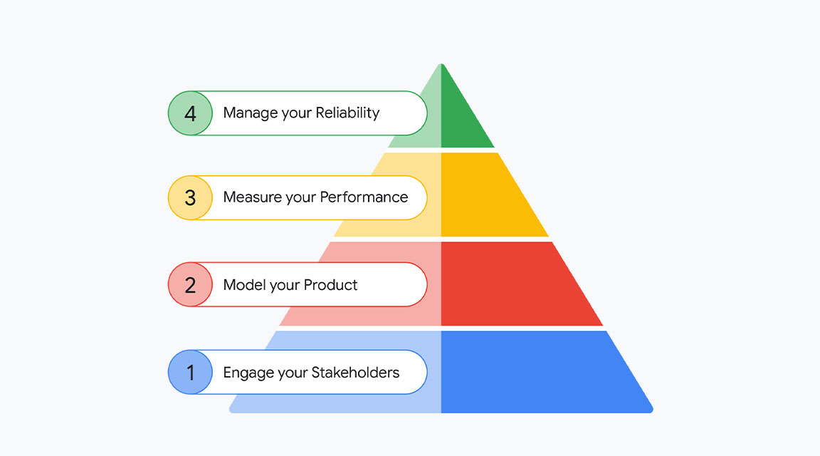

Slide 28
Key Concepts of SRE
Reliability as a Feature:
SRE treats reliability as a core feature of software, prioritizing it alongside functionality. Reliability is considered a key metric for user satisfaction and business success.
Service Level Objectives (SLOs), Service Level Indicators (SLIs), and Service Level Agreements (SLAs):
SLOs: Specific, measurable goals for system reliability, such as availability or latency.
SLIs: Metrics that measure the performance of the system, like request latency or error rate.
SLAs: Formal agreements that define the expected level of service and consequences if those levels are not met.
Error Budgets:
SRE introduces the concept of an error budget, which is the acceptable amount of downtime or errors a service can have within a specific period. It balances the need for reliability with the pace of innovation, allowing teams to take risks and push updates as long as they stay within the budget.
Automation:
SRE emphasizes automation to reduce manual intervention and human error. By automating repetitive tasks, SREs can focus on higher-value activities such as optimizing system performance and reliability.
Incident Management:
SREs are responsible for managing incidents, ensuring quick resolution, and conducting post-mortems to prevent recurrence. This involves creating runbooks, automating recovery processes, and ensuring effective communication during incidents.
Monitoring and Observability:
SREs implement comprehensive monitoring to gain insights into system behavior. Observability tools allow teams to understand the internal states of the system based on the data (metrics, logs, traces) they collect.
Capacity Planning and Performance Management:
SREs perform capacity planning to ensure that systems can handle expected traffic and growth. They also work on performance tuning to meet SLOs and maintain efficient resource utilization.
Blameless Post-Mortems:
After an incident, SREs conduct blameless post-mortems to analyze what went wrong without attributing fault to individuals. The focus is on learning and improving systems to prevent future incidents.

Slide 29
Roles and Responsibilities of SRE
System Design and Architecture: SREs collaborate with development teams to design systems that are scalable, reliable, and easy to maintain.
Operational Support: SREs provide operational support for services, including monitoring, incident response, and troubleshooting.
Automation and Tooling: SREs develop and maintain tools for automation, monitoring, deployment, and configuration management.
Capacity and Performance Management: SREs ensure that systems are performing optimally and can handle expected loads, performing capacity planning and resource optimization.
Incident Response: SREs respond to outages and incidents, working to restore services quickly and conducting root cause analysis afterward.
Continuous Improvement: SREs work on continuously improving system reliability by refining processes, automating tasks, and enhancing monitoring and alerting systems.

Slide 30
Devops VS SRE
DevOps:
Cultural Focus: DevOps is more of a cultural movement that promotes collaboration between development and operations teams.
Broad Scope: DevOps covers a wide range of practices, including CI/CD, infrastructure as code, and collaboration.
Tool and Process-Oriented: DevOps emphasizes the use of automation tools and processes to improve software delivery.
SRE:
Engineering Discipline: SRE is a specific engineering discipline that applies software engineering principles to operations and reliability.
Reliability Focus: SRE prioritizes reliability and availability of systems, often balancing these with the need for rapid development.
Error Budgets: SRE introduces the concept of error budgets to manage the trade-off between reliability and development velocity.

Slide 31
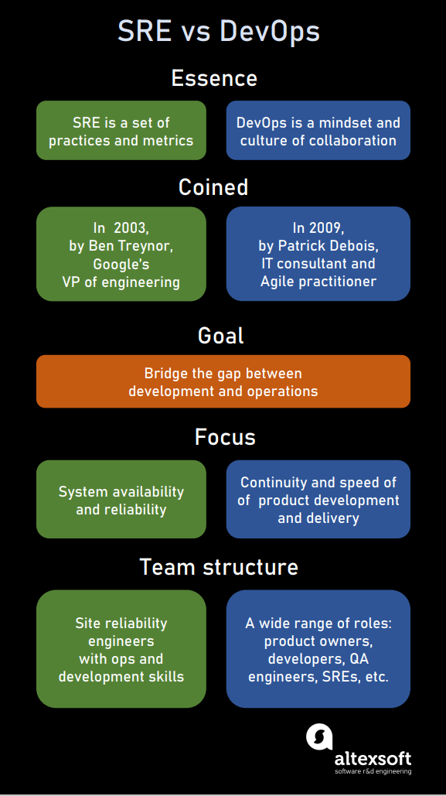

Slide 32
SRE Technology Stack
Monitoring and Observability: Prometheus, Grafana, ELK Stack (Elasticsearch, Logstash, Kibana), Datadog, New Relic.
Incident Management: PagerDuty, Opsgenie, VictorOps.
Automation and Configuration Management: Terraform, Ansible, Puppet, Chef, Kubernetes.
Version Control and CI/CD: Git, Jenkins, GitLab CI/CD.
Load Testing and Performance Management: Apache JMeter, Gatling, LoadRunner.

Slide 33
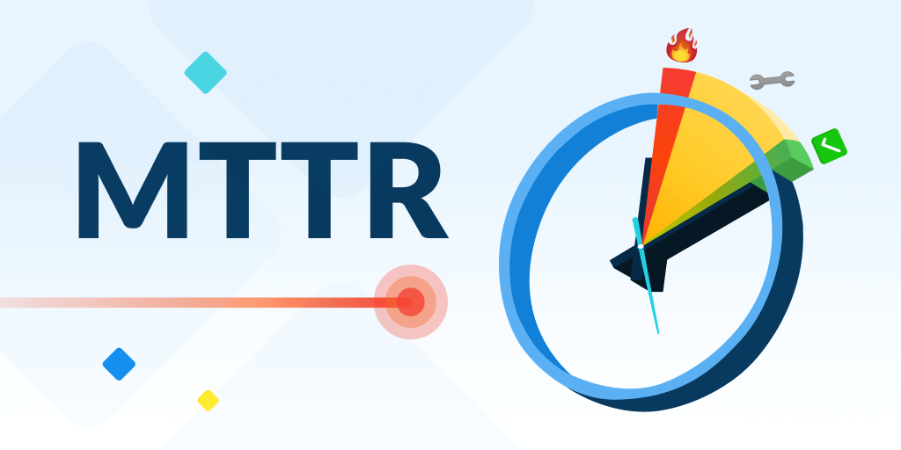

Slide 34
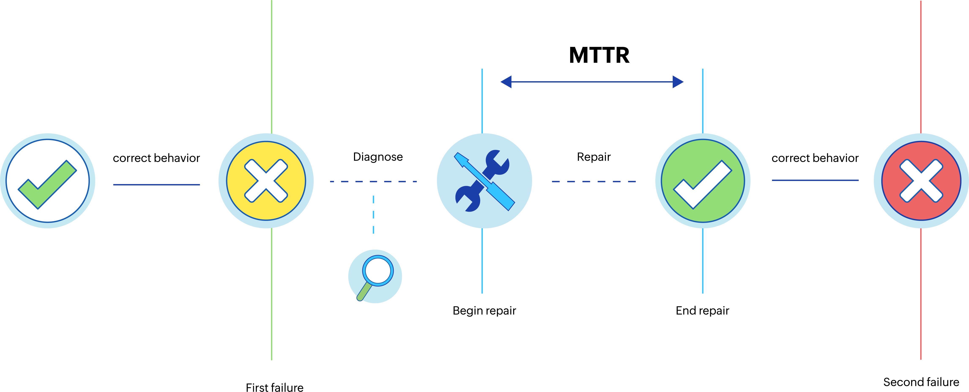

Slide 35
Key Terminologies:-
MTTR (Mean Time to Repair) -
MTTR is the average time it takes to repair a system or component and restore it to operational condition after a failure has occurred.
Calculation – MTTR = Total Downtime /number of Failure
Purpose: MTTR is used to measure the efficiency of the repair process. A lower MTTR indicates that issues are resolved quickly, minimizing downtime and its impact on users.
Application: MTTR is critical in environments where minimizing downtime is essential, such as in data centers, manufacturing, and IT services.

Slide 36


Slide 37
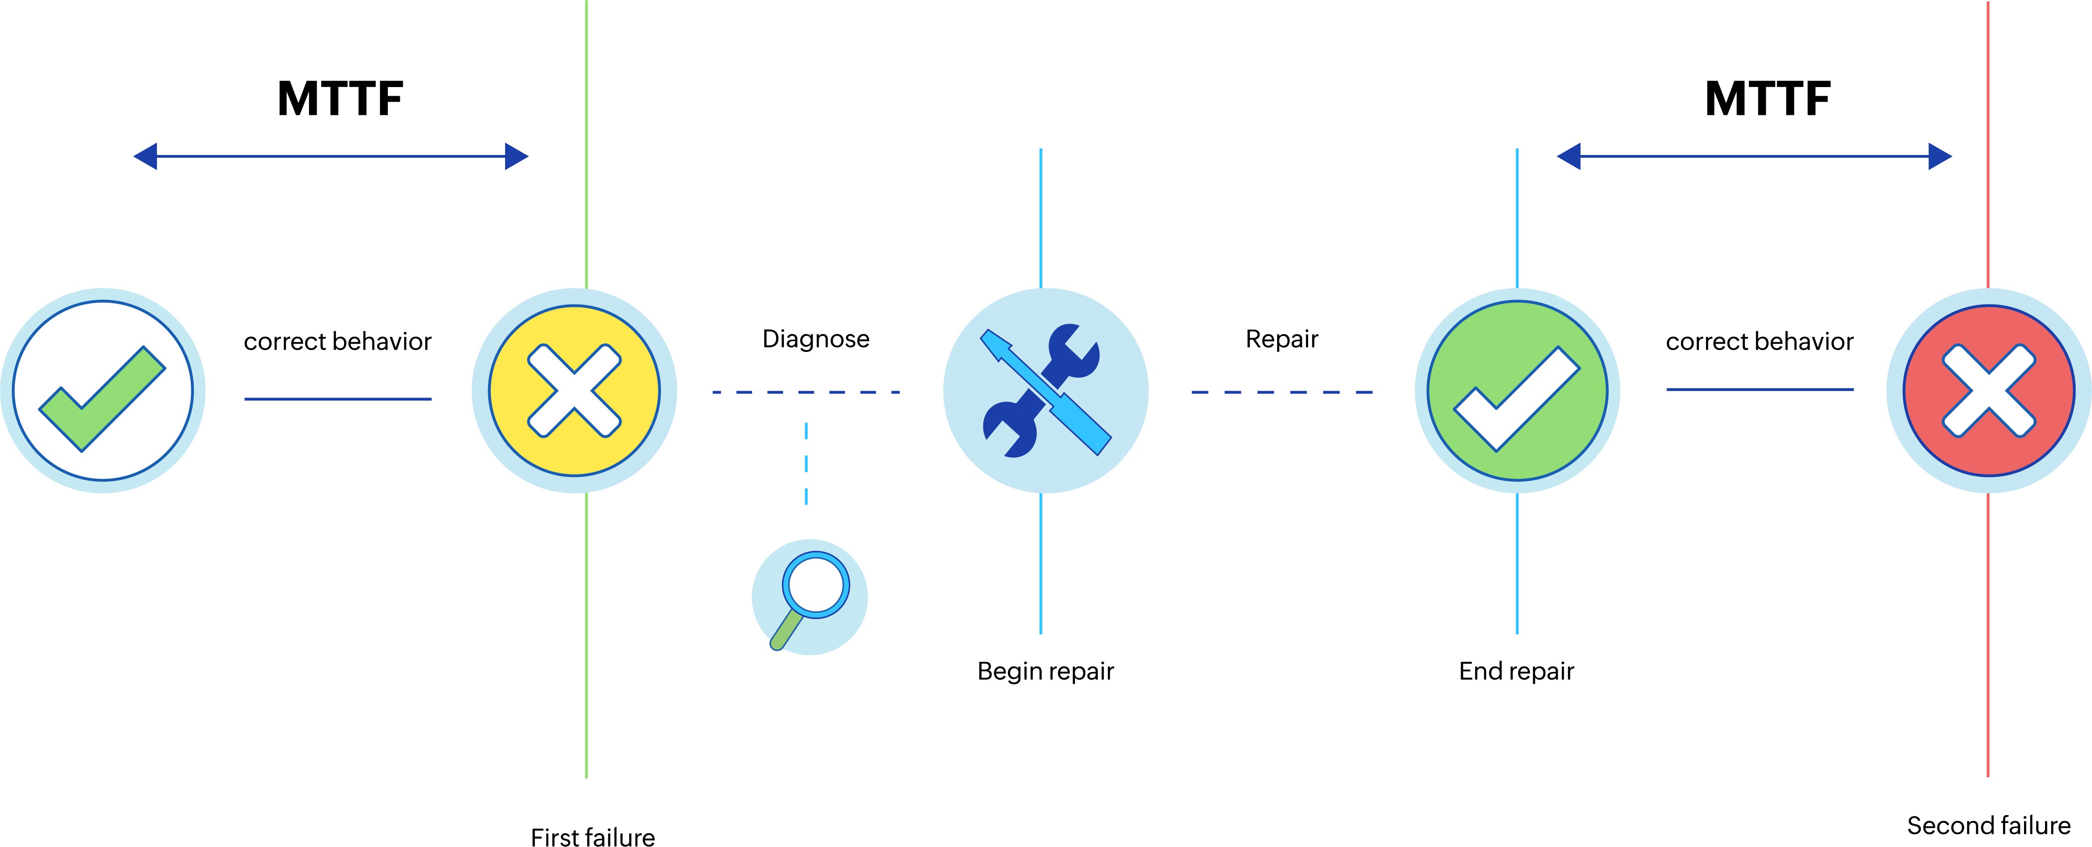

Slide 38
MTTF (Mean Time to Failure) –
Definition: MTTF is the average time that a non-repairable system or component operates before it fails. It is used to predict the lifespan or reliability of a product.
Calculation – MTTF = Total Operation Time / Number of Failures
Purpose: MTTF helps in understanding the expected lifespan of a component or system. It is typically used for non-repairable items (e.g., light bulbs, batteries).
Application: MTTF is useful in product design, warranty analysis, and planning for replacements in systems where components are not repairable but are instead replaced upon failure.

Slide 39
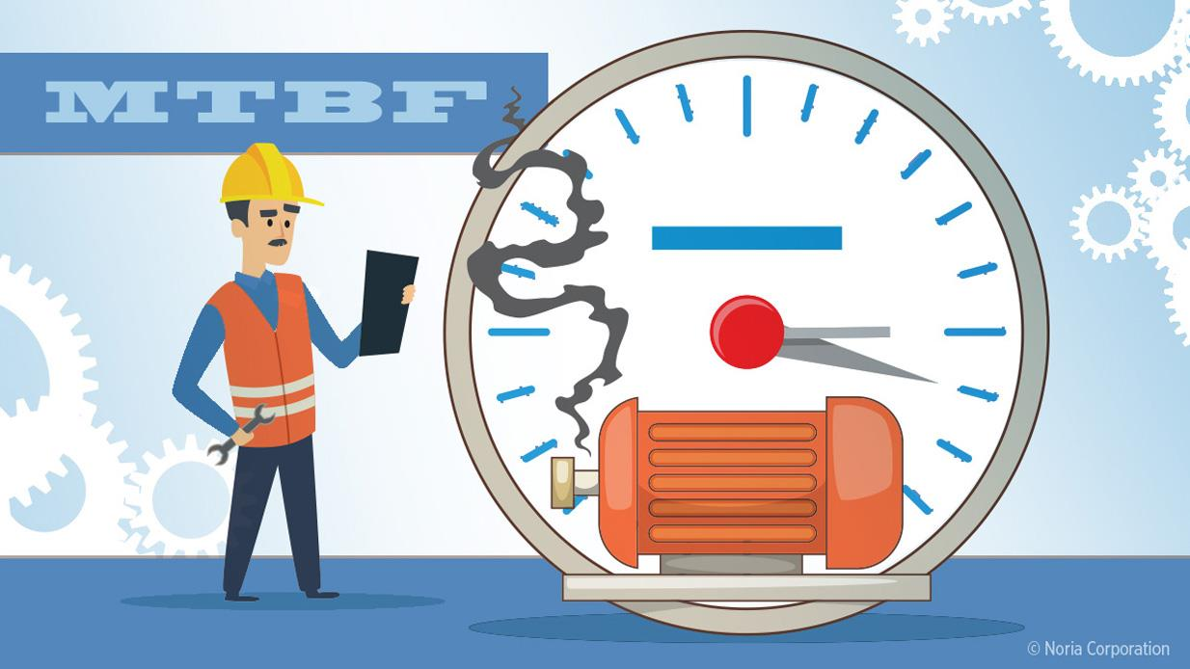

Slide 40
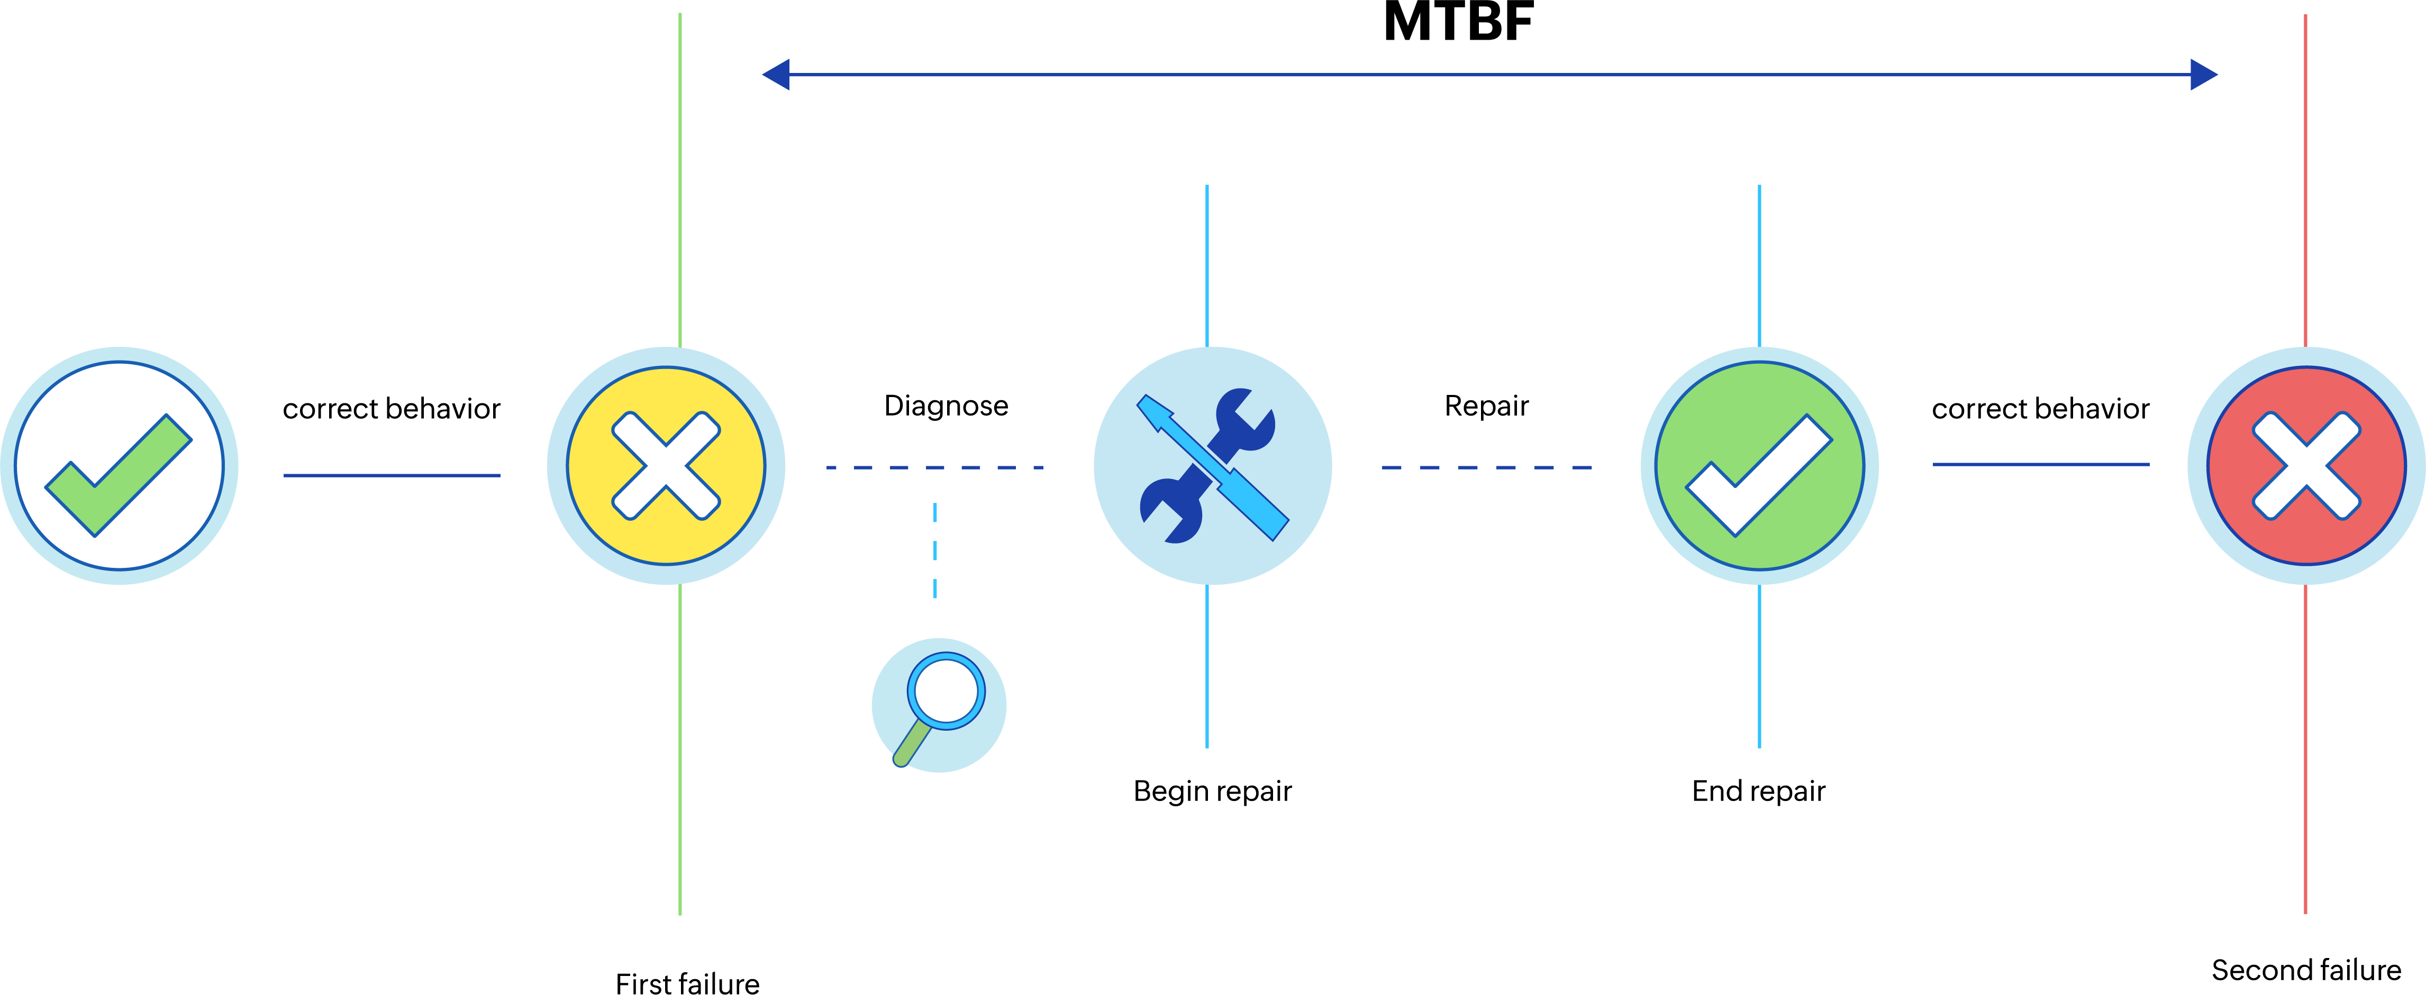

Slide 41
MTBF (Mean Time Between Failures) –
Definition: MTBF is the average time between two consecutive failures of a system or component. Unlike MTTF, MTBF applies to repairable systems.
Calculation – MTBF = Total Operation Time / Number of Failures
Purpose: MTBF is used to predict the reliability of a system and to plan maintenance schedules. A higher MTBF indicates that the system is more reliable and less prone to frequent failures.
Application: MTBF is widely used in industries like aerospace, manufacturing, and IT to assess and improve system reliability.

Slide 42
How These Metrics Relate to Each Other
MTTR is concerned with how quickly a system can be repaired after a failure.
MTTF is concerned with the expected time until a non-repairable system fails.
MTBF combines both reliability (time between failures) and maintainability (time to repair) for repairable systems.

Slide 43
Example Scenario
Consider a server system:
If the MTTR is 2 hours, this means on average, it takes 2 hours to repair the server and get it back online after a failure.
If the MTTF is 10,000 hours, this indicates that the server is expected to run for 10,000 hours on average before experiencing an irreversible failure (if it were non-repairable).
If the MTBF is 15,000 hours, this means that the server is expected to operate for 15,000 hours on average between failures (considering it is repairable).

Slide 44
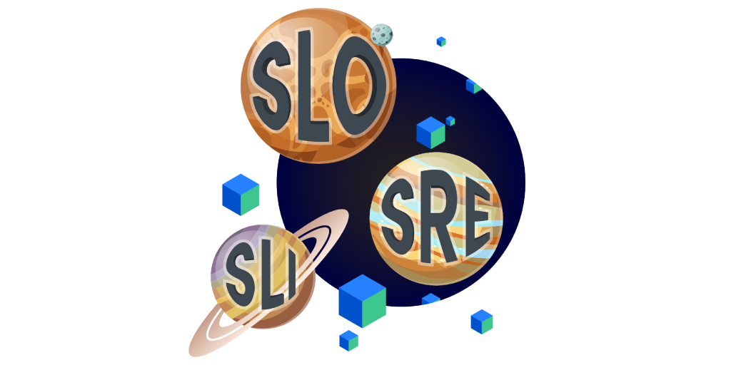

Slide 45
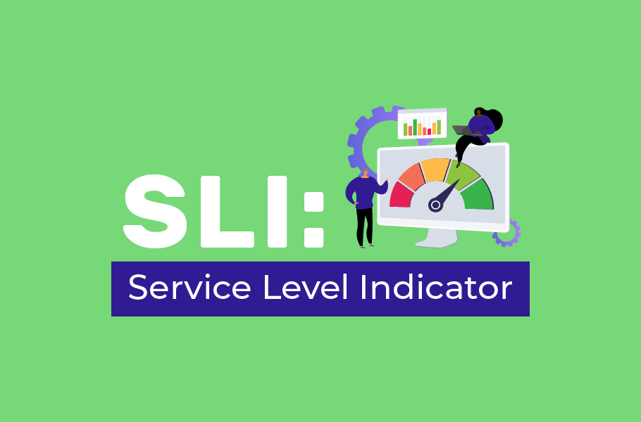

Slide 46
SLI (Service Level Indicators)
Definition: An SLI is a specific metric used to measure the performance or reliability of a service. It quantifies aspects such as availability, latency, error rates, or system throughput.
Purpose: SLIs provide the raw data needed to understand how well a service is performing in key areas that impact user experience.
Examples:
Availability SLI: Percentage of time a service is operational (e.g., "Service was available 99.95% of the time").
Latency SLI: The average time it takes for a request to be processed (e.g., "99% of requests are processed within 200ms").
Error Rate SLI: The percentage of failed requests (e.g., "0.1% error rate over the last month").

Slide 47
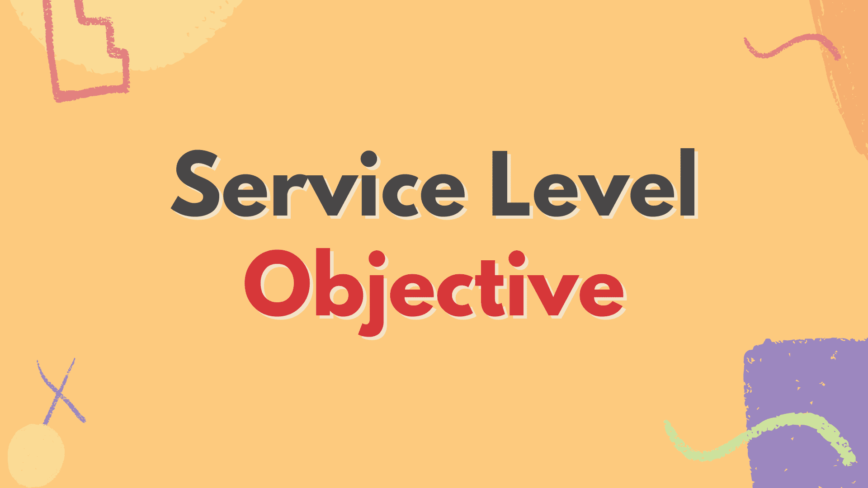

Slide 48
SLO (Service Level Objective)
Definition: An SLO is a specific target or goal set for an SLI. It defines the acceptable performance level of the service for that indicator over a period of time.
Purpose: SLOs serve as benchmarks for whether a service is meeting its expected performance levels. They help guide operational decisions and service improvements.
Examples:
Availability SLO: "The service should be available 99.9% of the time over the last month.“
Latency SLO: "95% of requests should be processed within 300ms.“
Error Rate SLO: "The error rate should not exceed 0.1% in a given week."

Slide 49
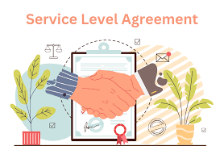

Slide 50
SLA (Service Level Aggrements)
Definition: An SLA is a formal contract between a service provider and a customer that defines the expected service performance, including penalties if the agreed-upon SLOs are not met.
Purpose: SLAs are legally binding agreements that hold the service provider accountable to the customer for maintaining certain service levels. They often include remedies or compensation in cases where the service does not meet the agreed-upon standards.
Examples:
Availability SLA: "The service will be available 99.9% of the time. If availability falls below this threshold, the provider will issue a 10% service credit.“
Response Time SLA: "Support tickets will receive an initial response within 4 hours. If this is not met, the customer is entitled to a discount."

Slide 51
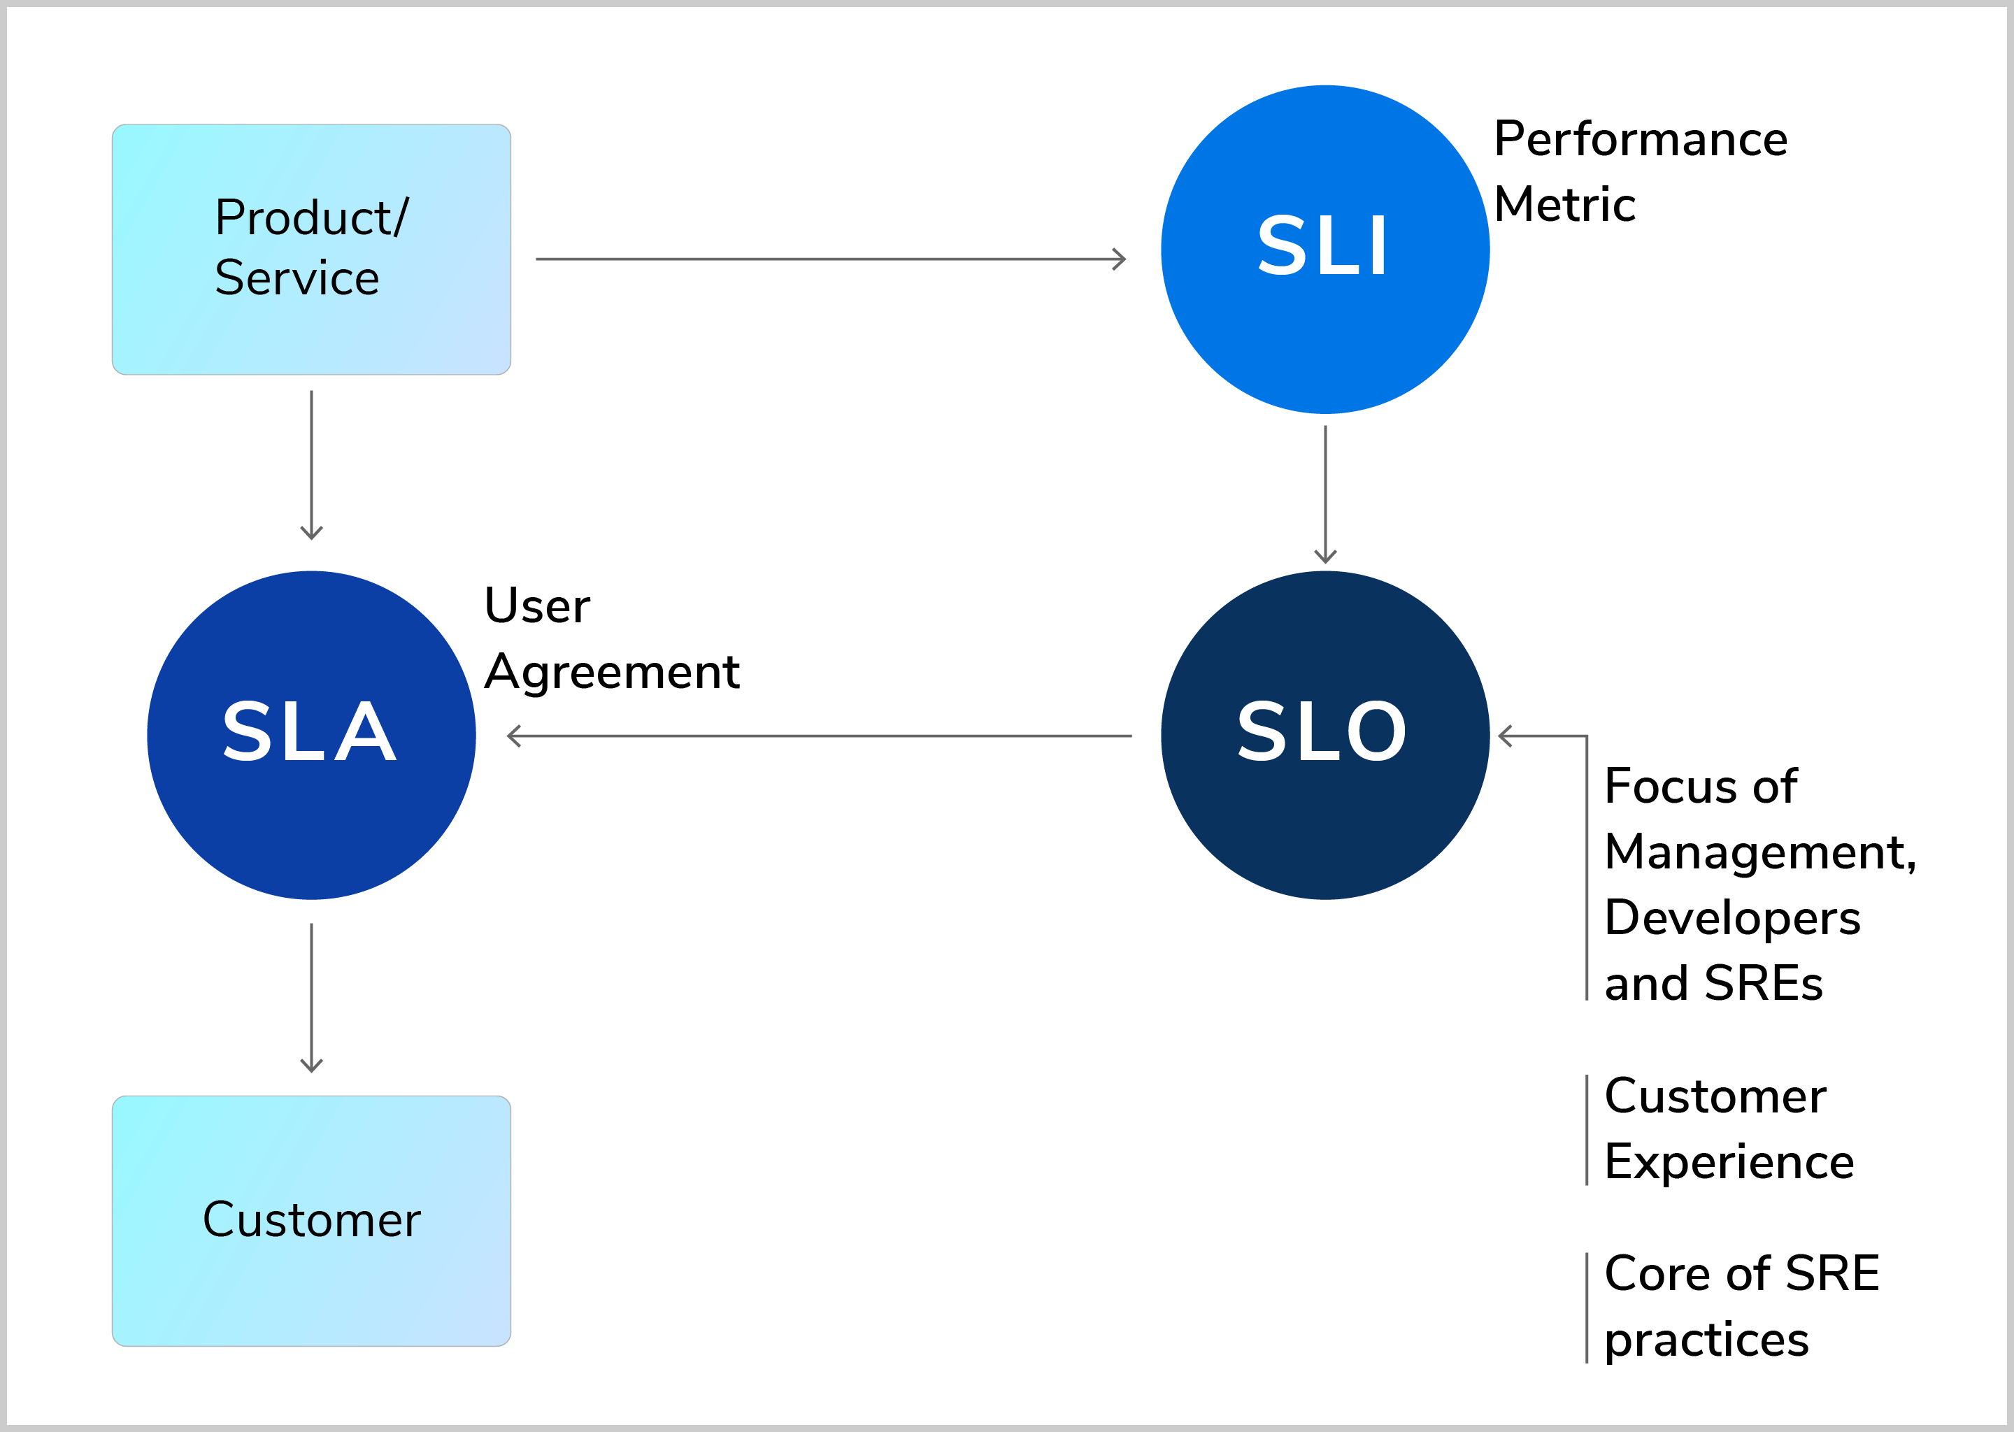

Slide 52
Relationship Between SLI, SLO, and SLA
SLIs are the metrics that measure specific aspects of service performance.
SLOs are the targets set for these SLIs, defining what acceptable performance looks like.
SLAs are the agreements that specify the SLOs that must be met, along with the consequences if they are not.

Slide 53
Example Scenario
Consider a cloud storage service:
SLI: The availability of the service is measured by tracking the percentage of time the service is up and running over a month.
SLI might show: "Service availability was 99.92% in August."
2. SLO: The service provider sets a target that the service should be available 99.9% of the time each month.
SLO: "Service should maintain 99.9% availability each month."
3. SLA: The provider agrees with the customer that if the availability drops below 99.9% in any month, the customer will receive a service credit.
SLA: "If availability drops below 99.9% in any month, the customer will receive a 15% credit on their monthly bill."

Slide 54
Risk and Error Budgeting
Risk and Error Budgeting are crucial concepts in the field of Site Reliability Engineering (SRE) and IT service management. They help organizations balance the need for innovation and changes (like deploying new features) with the need for reliability and stability in their systems.

Slide 55
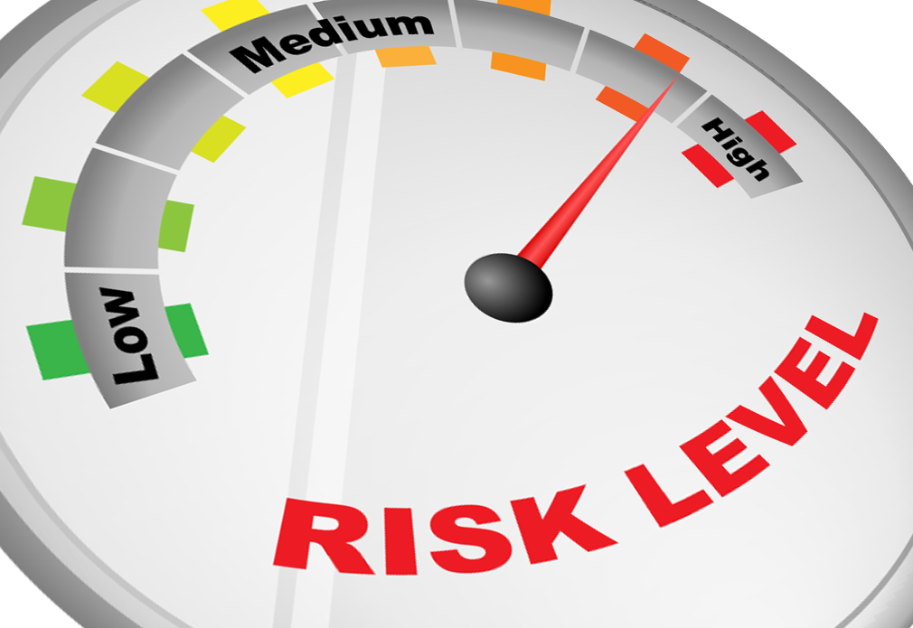

Slide 56
Risk Management in SRE
Risk management involves identifying, assessing, and prioritizing risks to an organization's systems and services. It aims to minimize the impact of potential failures or incidents on the business and its customers.
Identification: Recognizing potential risks that could affect service reliability, such as increased load during peak times, hardware failures, or software bugs.
Assessment: Analyzing the likelihood and potential impact of these risks. For instance, a critical system might have a high impact if it fails, but the likelihood might be low due to redundancies.
Prioritization: Determining which risks are most critical to address based on their impact and likelihood. This helps in allocating resources effectively.
Mitigation: Implementing strategies to reduce the likelihood of these risks or their impact. This could include redundancy, automation of failover processes, or thorough testing of changes before deployment.

Slide 57


Slide 58
Error Budgeting
An Error Budget is a key concept that helps in managing risk by quantifying the acceptable level of unreliability in a system. It’s a way to balance the need for system reliability with the desire to release new features or updates.
Key Concepts of Error Budgeting:
Error Budget:
An error budget represents the maximum allowable amount of downtime or failure within a given period, based on the Service Level Objective (SLO).
If the SLO is 99.9% uptime for a month, this means the error budget is 0.1% downtime, which translates to about 43.2 minutes of allowable downtime per month.
Usage of Error Budgets:
Encourage Innovation: When the error budget is not fully consumed, teams are encouraged to deploy new features, make changes, and innovate, knowing that the system’s reliability is within acceptable limits.
Throttle Changes: If the error budget is nearly exhausted or exceeded (meaning the system has been less reliable than promised), changes are halted or slowed down. This period is used to stabilize the system and improve reliability.
Decision-Making Tool: Error budgets serve as a guide for decision-making. For example, if a service is frequently failing, consuming its error budget, the team might prioritize reliability improvements over new feature development.
Error Budget Policy:
A formalized approach that defines how teams should behave based on the current state of the error budget. It outlines the actions to take when the budget is nearly exhausted, such as freezing releases, conducting in-depth root cause analyses, or reallocating resources to improve system stability.

Slide 59
Example Scenario
Let’s say an online service commits to 99.9% uptime in its SLA, allowing for roughly 43 minutes of downtime per month.
Error Budget Calculation: The error budget is 43 minutes per month.
Risk Assessment: The team knows that deploying new features always carries a risk of introducing bugs that could cause downtime.
Using the Error Budget:
Early in the month, if the system has had no significant issues, there’s still a full 43 minutes available in the error budget. The team might decide to proceed with several feature releases.
However, if a major incident occurs and consumes 30 minutes of downtime, only 13 minutes remain in the error budget. The team might then decide to hold off on further risky deployments until the next month, focusing instead on reliability improvements.

Slide 60
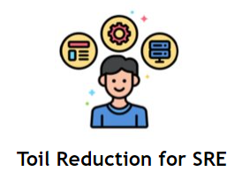

Slide 61
Toil
Toil refers to the repetitive, manual, and operational work that is necessary to keep systems running but doesn’t contribute to long-term improvements or innovations. It is often considered unproductive work that consumes resources without adding significant value or improving the system's reliability.
Characteristics of Toil:
Manual and Repetitive: Tasks that are performed manually and repeatedly, such as manual deployments, routine server reboots, or data backups.
No Long-Term Value: Tasks that don’t contribute to the improvement of the system or its processes. They are necessary but don't lead to long-term enhancements.
Operational Overhead: Work that distracts from engineering tasks and can lead to burnout or inefficiency.
Examples of Toil:
Manual system reboots or patching.
Handling routine ticketing or customer support tasks.
Repeatedly resolving the same types of incidents or failures.
Performing regular but monotonous monitoring checks.

Slide 62
Example of Toil Budgeting in Practice:
Identify Toil: An SRE team identifies that 40% of their time is spent on repetitive tasks such as manually scaling resources or responding to routine alerts.
Set a Toil Budget: The team sets a goal to reduce toil to 20% of their time within the next quarter.
Implement Automation: The team invests in automation tools to handle scaling and alerting tasks automatically, reducing the manual workload.
Track Progress: The team tracks the reduction in toil and measures the impact on their productivity and the time available for engineering tasks.
Adjust Strategies: Based on the results, the team may adjust their strategies, refine automation tools, or set new goals for further reducing toil.

Slide 63
SRE Principles
Site Reliability Engineering (SRE) is guided by a set of core principles and practices designed to ensure that systems are reliable, scalable, and efficient. Here are the key principles that underpin SRE:
Reliability as a Product
Principle: Reliability is a key product feature, not a byproduct. Just like functionality and performance, reliability should be intentionally designed and managed.
Practice: Define clear Service Level Objectives (SLOs) and continuously measure and improve reliability based on these objectives.
Service Level Objectives (SLOs)
Principle: SLOs are measurable targets that define the expected reliability of a service. They are crucial for understanding and managing the trade-offs between reliability and new features or changes.
Practice: Set clear, realistic SLOs based on user needs and system capabilities. Use SLOs to guide decision-making and prioritize engineering work.
Error Budgets
Principle: Error budgets quantify the allowable level of unreliability. They provide a balance between pushing for new features and maintaining system reliability.
Practice: Track error budgets and use them to guide development and operational decisions. When error budgets are exhausted, focus on improving reliability before pursuing new changes.
Blameless Culture
Principle: A blameless culture encourages open communication and learning from failures without assigning individual blame. This fosters continuous improvement and collaboration.
Practice: Conduct blameless post-mortems to analyze incidents and derive actionable insights. Focus on systems and processes, not individuals.
Automation
Principle: Automating repetitive and manual tasks reduces human error and frees up time for more valuable work. Automation is key to scaling operations efficiently.
Practice: Invest in automation for deployment, monitoring, incident response, and other operational tasks. Continuously seek opportunities to automate manual processes.
Monitoring and Observability
Principle: Comprehensive monitoring and observability are essential for understanding system behavior and performance. They help detect issues early and support effective incident management.
Practice: Implement robust monitoring systems that provide insights into metrics, logs, and traces. Use these tools to gain visibility into system health and performance.

Slide 64
Capacity Planning and Management
Principle: Effective capacity planning ensures that systems can handle expected loads and growth without performance degradation or failures.
Practice: Perform regular capacity assessments, forecast future needs, and plan for scalability. Adjust resources and configurations based on current and projected demand.
Incident Management
Principle: Efficient incident management minimizes the impact of failures and ensures a swift return to normal operations. Clear processes and communication are crucial during incidents.
Practice: Develop and maintain runbooks, establish incident response protocols, and ensure teams are trained in effective incident management. Conduct post-incident reviews to improve future responses.
Continuous Improvement
Principle: Continuous improvement focuses on iterating and refining processes, systems, and practices to enhance reliability and efficiency over time.
Practice: Regularly review and update processes, tools, and practices based on feedback and performance metrics. Embrace a mindset of ongoing learning and adaptation.
Focus on User Experience
Principle: The ultimate goal of SRE is to deliver a reliable and high-quality user experience. Understanding user impact helps prioritize reliability efforts.
Practice: Gather and analyze user feedback to understand their needs and expectations. Use this information to guide SLOs, reliability goals, and operational decisions.

Slide 65
SRE Practices
Site Reliability Engineering (SRE) practices are specific methods and processes that help implement the core principles of SRE effectively. These practices focus on ensuring system reliability, scalability, and efficiency. Here are key SRE practices:
Service Level Objectives (SLOs) and Service Level Indicators (SLIs)
Define SLIs: Identify key metrics that reflect the reliability and performance of your services. Examples include request latency, error rates, and availability.
Set SLOs: Establish target levels for each SLI that define acceptable performance and reliability. SLOs should be measurable and aligned with user expectations.
Monitor SLOs: Continuously track SLIs against SLOs to assess service performance and reliability.
Error Budgets
Calculate Error Budgets: Determine the maximum allowable level of unreliability based on your SLOs. An error budget is the difference between the SLO target and the actual reliability.
Manage Error Budgets: Use error budgets to guide decision-making. If the error budget is consumed, prioritize reliability improvements over new feature development.
Communicate Error Budgets: Share error budget status with teams to align on priorities and drive focus on reliability improvements.

Slide 66
Incident Management
Prepare Incident Response: Develop and maintain runbooks and incident response plans. Ensure teams are trained to handle incidents effectively.
Incident Detection: Use monitoring and alerting systems to detect and respond to incidents promptly.
Post-Incident Reviews: Conduct blameless post-mortems to analyze incidents, identify root causes, and implement improvements to prevent recurrence.
Monitoring and Observability
Implement Monitoring: Set up comprehensive monitoring systems to track metrics, logs, and traces. Ensure visibility into system performance and health.
Enhance Observability: Use observability tools to gain deeper insights into system behavior and troubleshoot complex issues.
Alerting: Configure alerts to notify teams of potential issues before they impact users. Ensure alerts are actionable and prioritize them effectively.
Capacity Planning and Management
Assess Capacity Needs: Regularly evaluate current and future capacity requirements based on expected loads and growth.
Plan for Scalability: Design systems to scale horizontally or vertically to handle increased demand.
Monitor Utilization: Track resource usage and adjust capacity as needed to avoid performance degradation.
Automation
Automate Operations: Implement automation for repetitive tasks such as deployments, scaling, and incident response. This reduces manual effort and minimizes errors.
Improve Efficiency: Continuously seek opportunities to automate manual processes and improve operational efficiency.
Change Management
Change Approval: Implement processes for reviewing and approving changes to minimize the risk of introducing issues.
Gradual Rollouts: Use strategies such as canary releases or blue-green deployments to gradually introduce changes and monitor their impact.
Rollback Procedures: Prepare and test rollback procedures to quickly revert changes if issues arise.

Slide 67
Capacity and Performance Testing
Conduct Load Testing: Perform load and stress testing to validate system performance under different conditions and loads.
Simulate Failures: Test how systems handle failures and recover from them to ensure resilience and reliability.
Documentation and Knowledge Sharing
Document Processes: Maintain up-to-date documentation for processes, runbooks, and incident management procedures.
Share Knowledge: Foster a culture of knowledge sharing and continuous learning. Share insights from incidents and improvements with the team.
Blameless Culture
Promote Learning: Encourage a blameless approach to incident analysis and continuous improvement. Focus on learning and improving systems and processes.
Foster Collaboration: Promote teamwork and collaboration across engineering, operations, and other teams to address issues effectively and improve reliability.

Slide 68
Thank You

